Slide 1


PRECISION MANUFACTURING
Precision metal parts
& integrated assemblies
Engineering support and coordinated production
for custom components and complete assemblies.
COMPANY PROFILE
Notes:
中文讲解
您好，我们是MANUVORA，位于深圳。我们的重点是定制五金零件，包括CNC加工、车削、冲压和钣金。同时，我们把模具、塑胶件、采购件、装配、检测和出货纳入同一个项目计划。您可以把单个零件交给我们，也可以委托我们完成多零件产品的整合交付。接下来先介绍可承接的具体工作，再展示制造和交付依据。
English talk track
Hello, we are MANUVORA, based in Shenzhen. Our main focus is custom metal parts, including CNC machining, turning, stamping and sheet metal. We also coordinate tooling, plastic components, purchased parts, assembly, inspection and shipment through one project team. You can work with us on an individual part or on a product that requires several manufacturing processes. Let me first explain what you can place with our team, then show the resources and controls behind the delivery.
客户交流 / Customer discussion
您目前主要采购单个零件，还是完整组件？
Do you mainly source individual parts or complete assemblies?
Sources
User-provided MANUVORA_Company_Profile_2026_Bilingual_Talk_Track_Editable(1).pptx, slides 1, 3, 5.
Photographs supplied in the PPTX and 新建文件夹.zip:
P01: image.jpeg

Slide 2

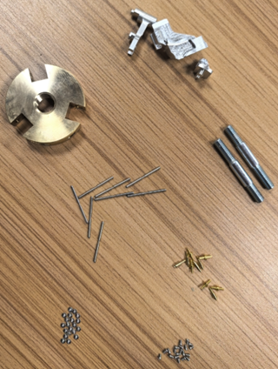
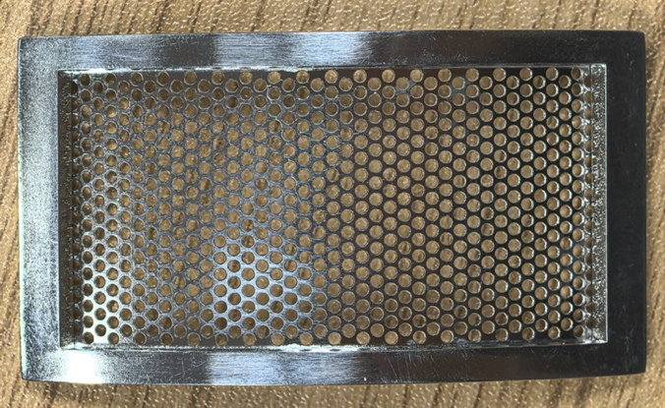
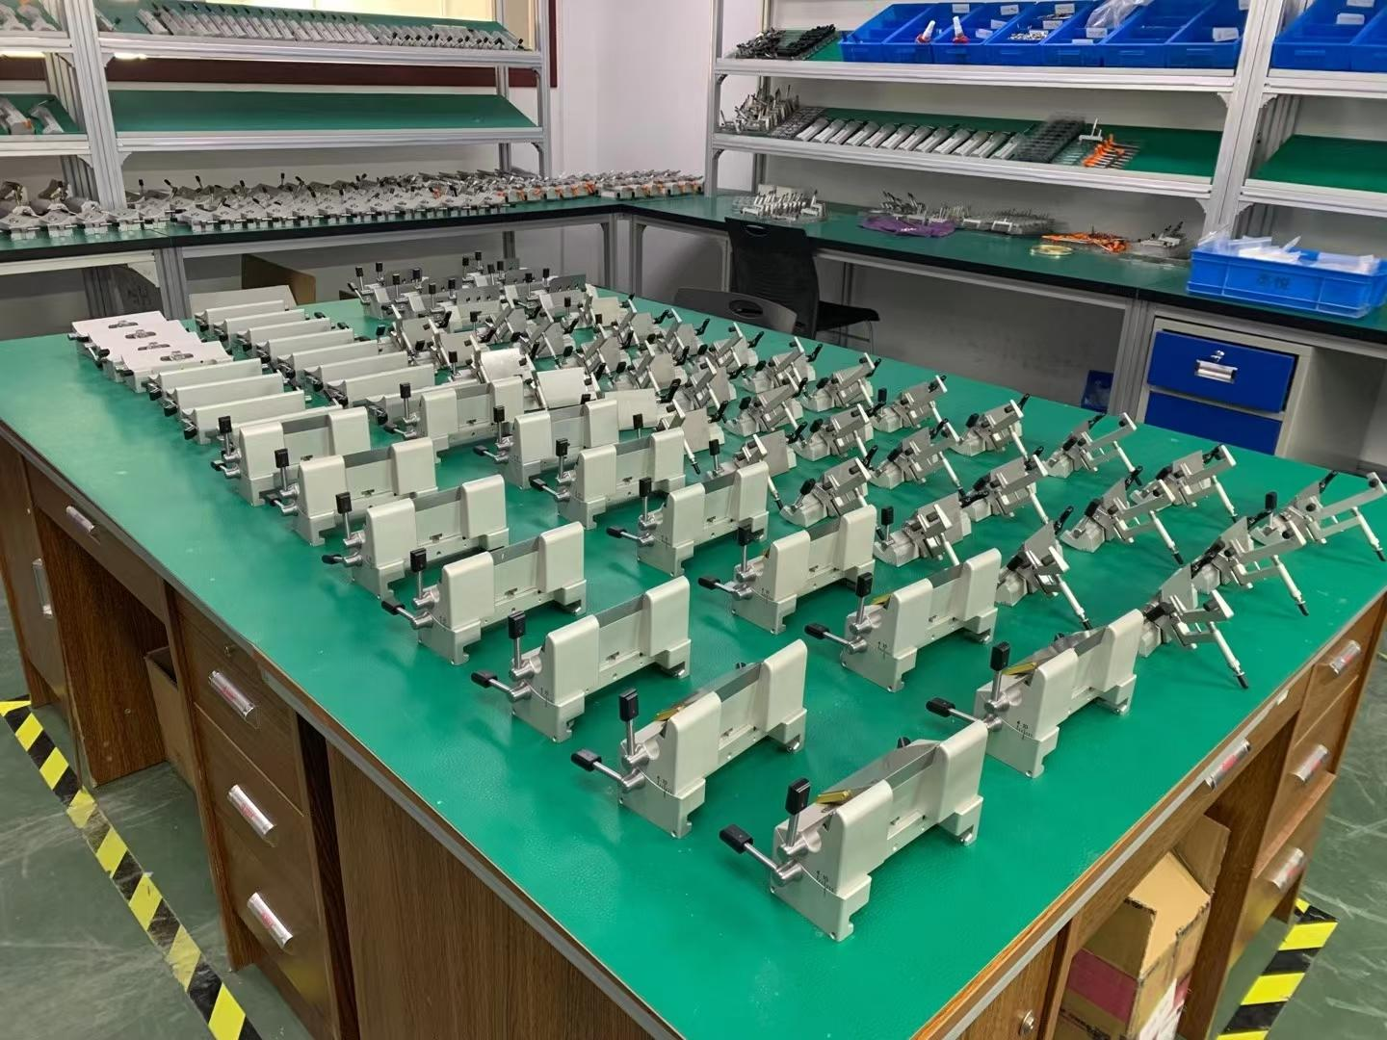
02
Precision metal parts
and integrated assemblies
Individual components
or a coordinated
assembly program.
CNC milling & turning
Stamping & sheet metal
Assembly & integration
Pins, shafts, sleeves,
housings and fixtures
Contacts, brackets,
covers and enclosures
Metal, plastic and purchased
parts within one project
Project support includes DFM, tooling, finishing, inspection and shipment.
Notes:
中文讲解
我们首先按客户最终需要收到的东西来介绍业务。第一类是CNC铣削和车削零件，例如PIN针、轴、套筒、外壳和治具。第二类是冲压与钣金零件，例如接触片、支架、罩壳和箱体。第三类是需要把五金、塑胶和采购件整合起来的多零件项目。DFM、模具、表面处理、检测和出货可以随项目范围一并规划。您可以从一个零件开始，也可以提供BOM和装配要求，由同一项目窗口协调。右侧照片展示装配治具资源。
English talk track
We describe our work through the items the customer needs to receive. CNC milling and turning cover parts such as pins, shafts, sleeves, housings and fixtures. Stamping and sheet metal cover contacts, brackets, covers and enclosures. We also coordinate products that combine metal, plastic and purchased components. DFM, tooling, finishing, inspection and shipment can be included in the agreed project scope. You can start with an individual part, or share a BOM and assembly requirements for one project team to coordinate. The right-hand photograph shows assembly fixture resources.
客户交流 / Customer discussion
您的采购需求更接近单个零件、多个零件，还是需要完成装配的产品？
Does your requirement involve an individual part, several parts, or an assembled product?
图片替换说明
三张图片均来自用户原稿。左侧来自第5页，中央保留原第2页图片，右侧来自第11页。右侧为治具资源照片，后续可替换为实际组装产品。替换图片时保留完整产品轮廓。

Slide 3
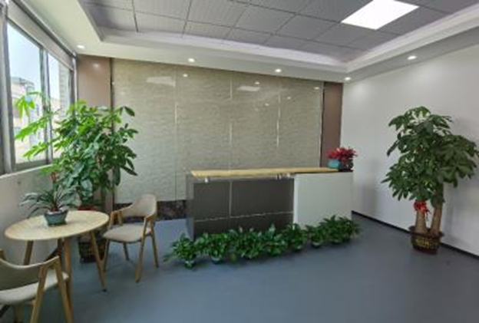
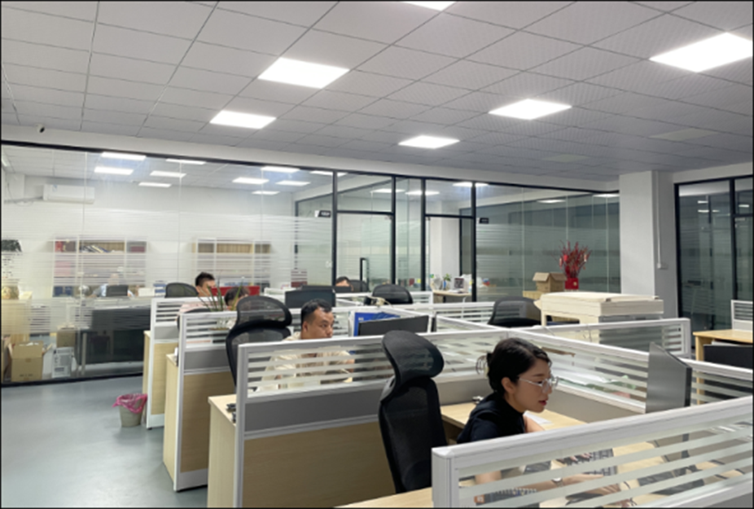
03
Engineering and
project ownership
One customer contact for engineering decisions
and production follow-up.
30
10
Core team
Engineering staff
Shenzhen, China. Established in 2010.
Notes:
中文讲解
MANUVORA成立于2026年，位于深圳。原公司资料中的核心团队人数为30人，其中工程人员10人。我们的角色是客户的项目责任窗口，统一处理技术澄清、图纸变更、生产协调、质量问题以及交付跟进。我们把工程沟通和现场执行连接起来，让客户在多个工艺之间仍然有明确的沟通对象。
English talk track
MANUVORA was established in 2026 in Shenzhen. Our company profile lists a core team of 30 people, including 10 engineering staff. We act as the customer-facing project owner, coordinating technical clarification, drawing changes, production, quality communication and delivery follow-up. This connects engineering decisions with execution across the manufacturing route and gives the customer a clear point of contact.
客户交流 / Customer discussion
您现在与供应商沟通时，最希望改善哪一个环节？
Which part of supplier coordination would you most like to improve?

Slide 4
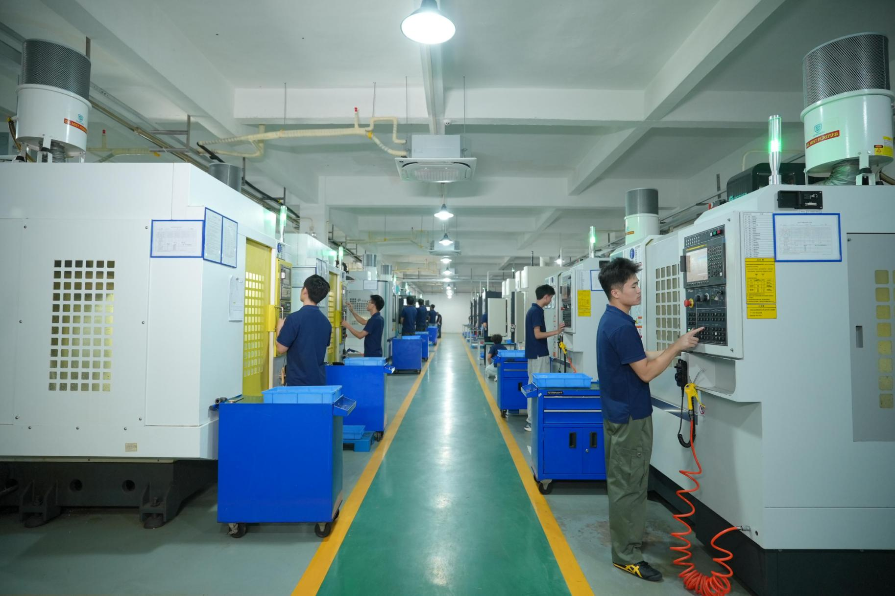
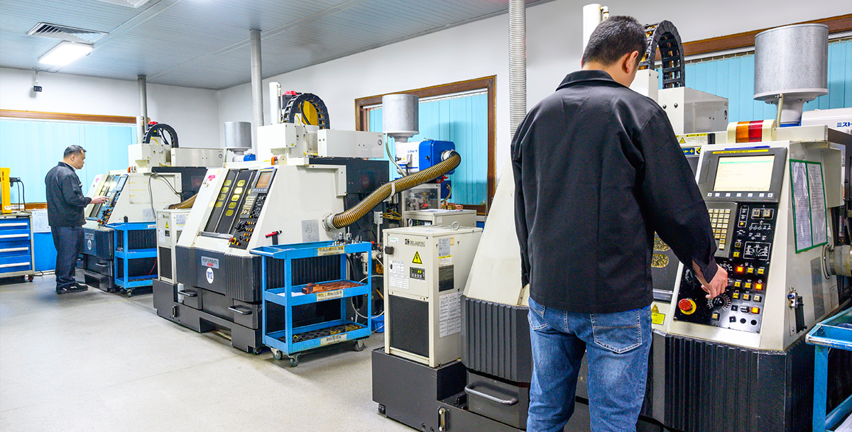
04
CNC
machining
Housings, plates
and fixtures
Aluminum and
stainless steel
Control of datums,
profiles and surface finish.
Production and inspection
follow the customer drawing.
Notes:
中文讲解
CNC铣削主要对应外壳、板类零件和治具等需求，原资料列明的典型材料包括铝和不锈钢。工程评审会先确定基准、关键轮廓、装夹方式和外观要求，再安排加工和检验。这里展示的是供应资料中的加工现场和生产网络资源。具体设备和工艺由项目的结构、数量、材料及验收要求决定。
English talk track
CNC milling supports housings, plates and fixtures. Typical materials in our profile include aluminum and stainless steel. During review, we identify the datums, critical profiles, setup requirements and surface-finish expectations before arranging production and inspection. These photographs show machining resources within our manufacturing network. Equipment allocation and the process route depend on the geometry, material, volume and acceptance requirements of each project.
客户交流 / Customer discussion
哪些表面或尺寸直接影响贵司的装配？
Which surfaces or dimensions directly affect your assembly?

Slide 5
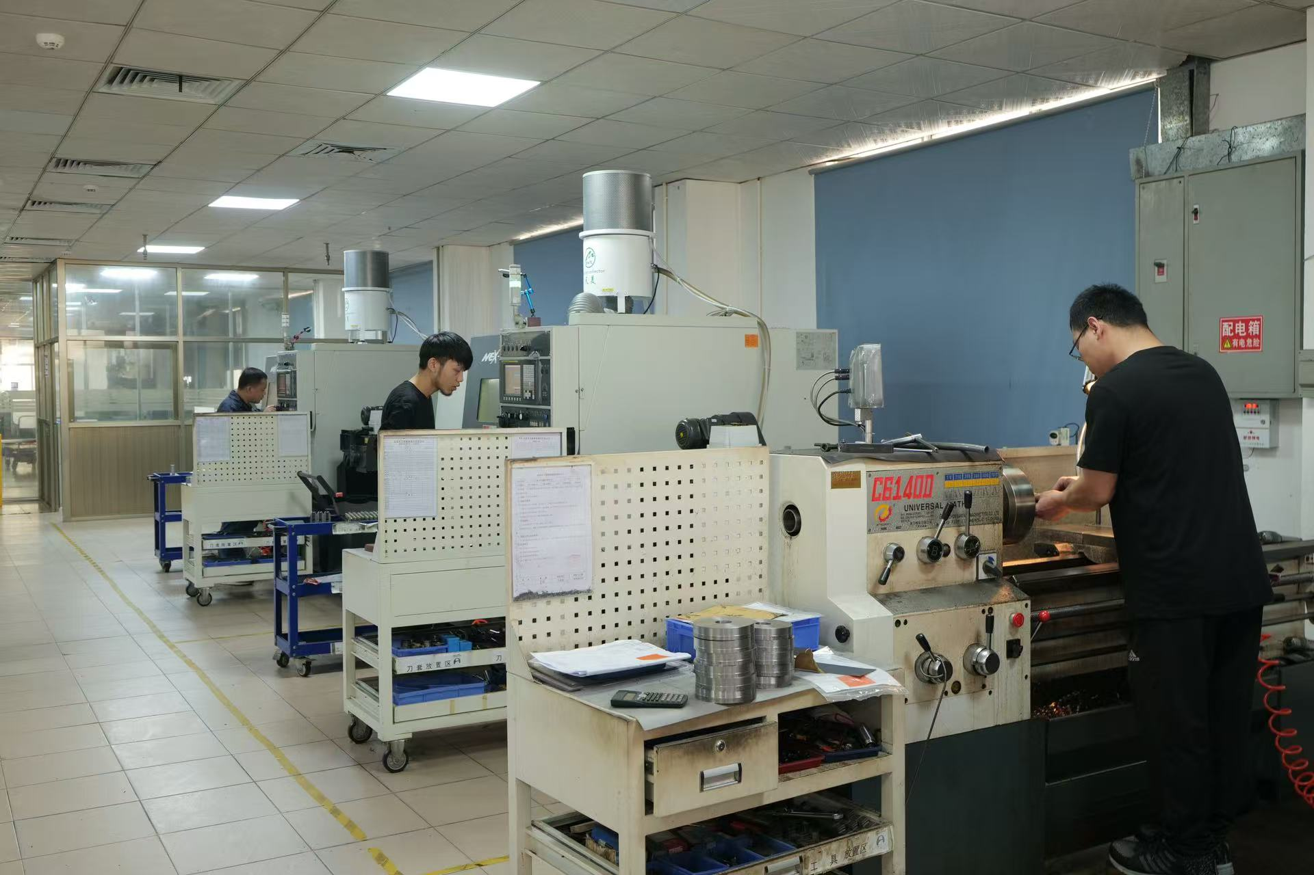
05
CNC
turning
Pins, shafts, sleeves
and connectors
Steel, brass and copper
PROCESS CONTROL
Diameters, threads
and concentricity
Notes:
中文讲解
车削适合PIN针、轴、套筒和连接件等回转类零件，典型材料包括钢、黄铜和铜。我们会重点确认直径、螺纹和同心度要求，同时检查零件在最终组件中的配合关系。下方保留了原稿中的小五金实物照片，右侧是所提供的数控车床车间。对于小零件，还会结合检验和装配需求考虑后续去毛刺、表面处理及包装。
English talk track
Turning supports pins, shafts, sleeves and connectors in materials such as steel, brass and copper. We review diameters, threads and concentricity together with the part’s fit in the final assembly. The smaller image shows actual part examples from our company profile, and the larger photograph shows the supplied turning workshop. For small components, we also coordinate the required deburring, finishing, inspection and packing operations.
客户交流 / Customer discussion
这些零件是否还有压入、拉拔力或配合要求？
Do these parts also have press-fit, pull-force or mating requirements?

Slide 6
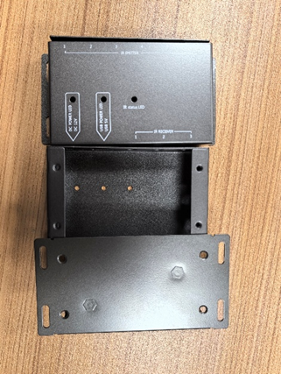
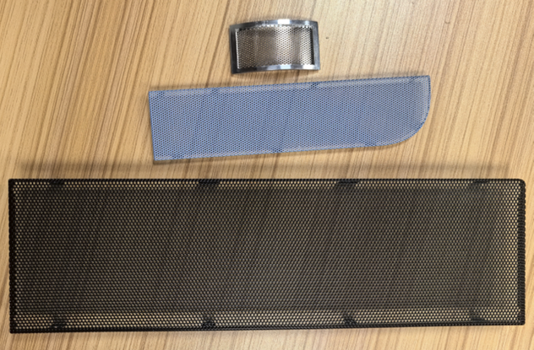
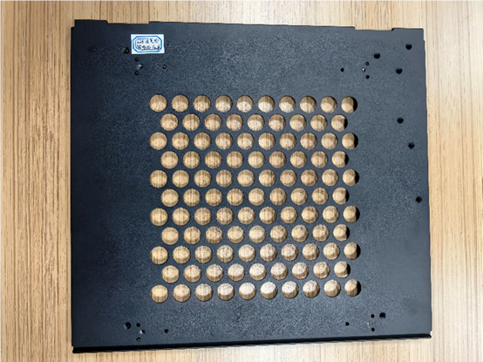
06
Stamping & sheet metal
Contacts, brackets, covers and fabricated enclosures.
Control of burrs, forming, bends, welds and cosmetic finish.
Enclosure components
Screens and covers
Perforated panel
Notes:
中文讲解
冲压与钣金覆盖接触片、弹片或支架、罩壳和箱体类零件。这里使用实际产品照片，让客户能够直接识别我们处理的零件类型。此类项目需要同时考虑结构尺寸、毛刺、折弯或成形、焊接及外观要求。我们会根据材料、结构和数量确认工艺路线，并把表面处理和最终装配要求一起纳入评审。
English talk track
Stamping and sheet-metal work cover contacts, formed brackets, covers and fabricated enclosures. These product photographs make the part families easy to recognize. For these projects, we review dimensional requirements alongside burr control, forming, bends, welds and cosmetic finish. We confirm the manufacturing route against the material, geometry and volume, including any finishing and final-assembly requirements.
客户交流 / Customer discussion
哪一类产品最接近贵司当前的采购需求？
Which of these part families is closest to your current sourcing needs?

Slide 7
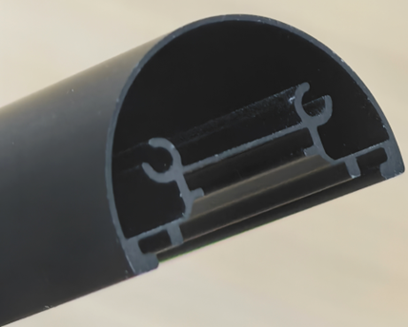
07
Secondary operations
Material, finishing requirements and inspection criteria
define the manufacturing route.
Profile-section example
Operation | Processes | Control focus
Edge preparation | Deburring and grinding | Edges and mating surfaces
Surface treatment | Anodizing and plating | Finish specification
Passivation | Passivation coordination | Material and process records
Supporting work | Heat treatment and marking | Drawing requirements
Material, process, tolerance and inspection requirements are confirmed for each project.
Notes:
中文讲解
客户的零件通常不只需要一道加工工序。我们可以按项目需要协调去毛刺、研磨、阳极氧化、电镀、钝化、热处理和标记。报价和生产前会确认图纸中的材料与表面规范，以及客户需要的检验和记录。右侧是原稿中的型材截面照片，作为产品类型展示，不代表本页列出的每一道工序都用于该零件。
English talk track
Many parts require more than one production step. We can coordinate deburring, grinding, anodizing, plating, passivation, heat treatment and marking as required by the project. Before quotation and production, we confirm the material, finish specification, inspection requirements and records. The profile-section photograph is a product example from our product examples. It does not imply that every operation on this page applies to that particular part.
客户交流 / Customer discussion
图纸是否指定了表面处理标准、外观样板或测试要求？
Does the drawing specify a finish standard, appearance sample or test requirement?

Slide 8
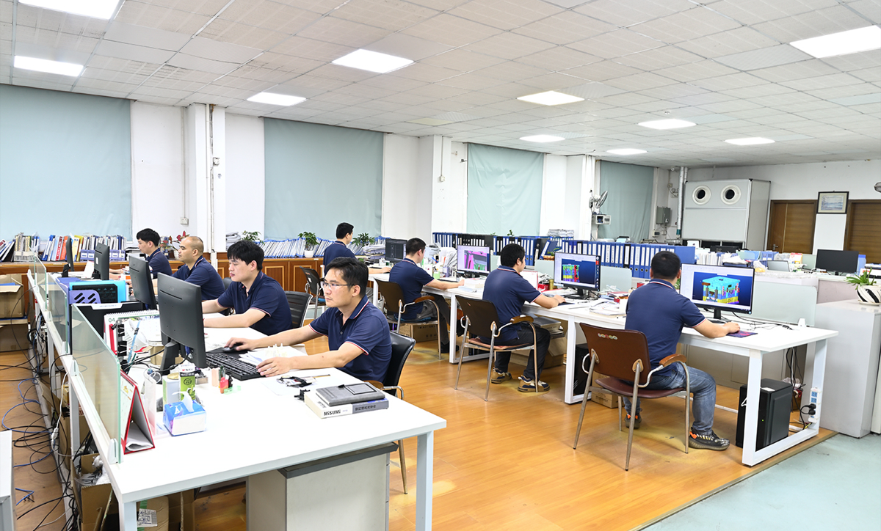
08
Engineering & DFM
Fit and tolerance control
before production
ILLUSTRATIVE REVIEW
Housing opening A
and insert width B
Illustrative dimensions for explanation. Actual project drawings and DFM records to be inserted.
Dimension (mm) | Initial | Proposed
Housing opening A | 10.00 ± 0.10 | 10.00 ± 0.05
Insert width B | 9.70 ± 0.10 | 9.70 ± 0.05
Total clearance | 0.10–0.50 | 0.20–0.40
Mating features, clearance
and tolerance budget
Target: 0.20–0.40 mm
A − B = 0.30 mm nominal.
Proposed limits meet this target.
Notes:
中文讲解
这页用一组示例尺寸说明公差配合评审的方法，不能作为真实项目的工程结论。假设外壳开口A为10.00±0.10毫米，装入件宽度B为9.70±0.10毫米，总间隙C=A−B，名义间隙为0.30毫米。按极限尺寸计算，最小间隙为9.90−9.80=0.10毫米，最大间隙为10.10−9.60=0.50毫米。假设本示例的目标总间隙为0.20至0.40毫米，初始公差范围不能满足目标。把两处公差分别调整为±0.05毫米后，最小间隙为9.95−9.75=0.20毫米，最大间隙为10.05−9.65=0.40毫米。实际项目还需要确认材料、温度、变形、基准、制造能力和测量方法，再决定是否采用该方案。本例只讨论一维刚性尺寸链的极限情况。总间隙不是单边间隙，也不是测试实测值。其他DFM项目可包括壁厚、拔模、加工与装配可达性、浇口、冷却及顶出风险。
English talk track
This illustrative example explains a tolerance review. It is not a conclusion from an actual customer project. Assume a housing opening A of 10.00±0.10 mm and an insert width B of 9.70±0.10 mm. Total clearance is A minus B, with a nominal value of 0.30 mm. Worst-case limits give a clearance range of 0.10 to 0.50 mm. If the assumed target is 0.20 to 0.40 mm, the initial tolerance limits do not meet the target. Changing each tolerance to ±0.05 mm produces a calculated clearance range of 0.20 to 0.40 mm. An actual project also requires review of materials, temperature, deformation, datums, process capability and inspection methods. This is a one-dimensional rigid-part worst-case calculation. Total clearance is not per-side clearance or measured test data. Other DFM reviews can cover wall thickness, draft, access, gating, cooling and ejection.
客户交流 / Customer discussion
哪些配合间隙和关键尺寸直接影响最终装配？
Which clearances and critical dimensions directly affect the final assembly?
替换说明
表格为可编辑的示例数据。获得实际项目资料后，替换尺寸、基准、目标范围、计算和结论。工程办公室照片保留自原稿，可后续替换为真实DFM标注或分析截图。示例目标范围没有外部标准依据，不能直接用于生产验收。
Sources
Company engineering capability and office photo: user-provided source slide 8. All numeric dimensions and tolerance targets are invented illustrative assumptions authorized for a replaceable draft. Clearance ranges are arithmetic calculations from those assumptions. No test was performed.

Slide 9
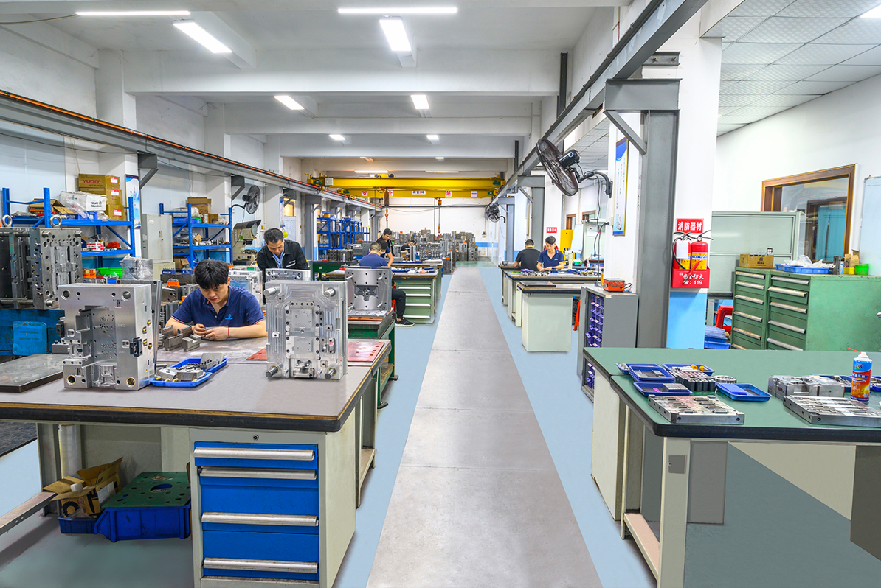
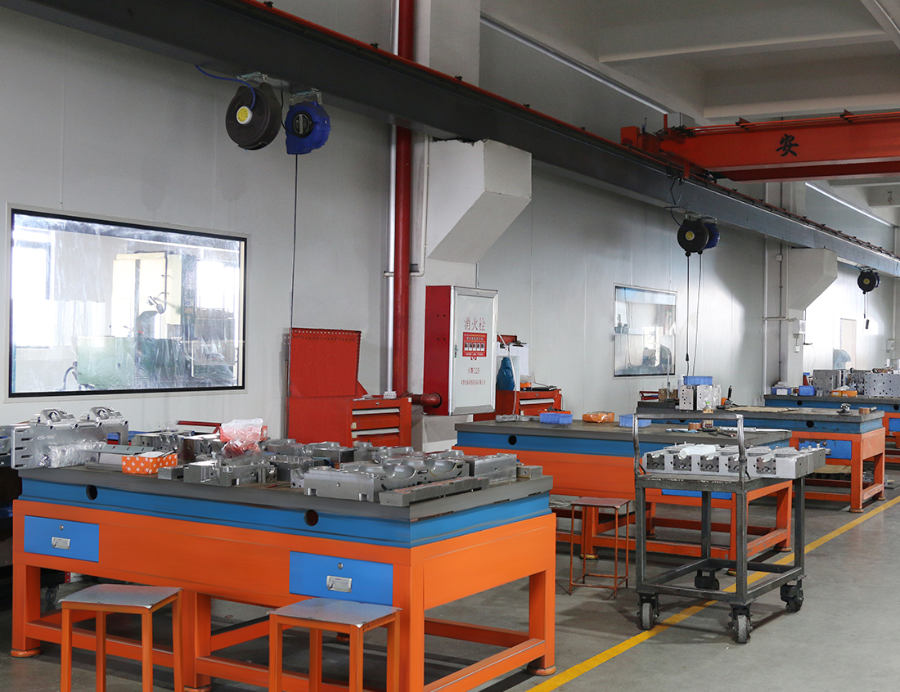
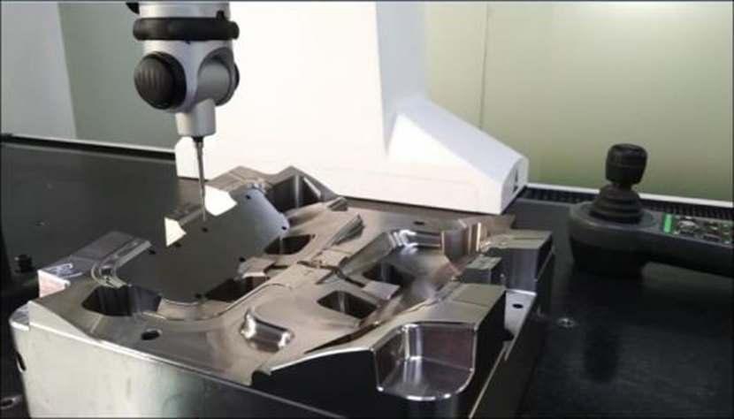
09
Toolmaking &
mold development
Tooling aligned to
assembly requirements
DFM review, tool build and trials,
with corrections before sample approval.
Gate and cooling review, ejection,
maintenance and engineering changes.
Tool workshop
Mold inspection
Notes:
中文讲解
对于包含塑胶件的产品，我们把模具作为最终装配的一部分来管理。开模前先评审拔模、壁厚、倒扣、浇口、冷却和顶出风险，随后进入加工、配模、试模、修正及样品批准。照片展示配模车间、模具车间和原稿中的模具检测。量产后还可以继续支持模具维护、维修及工程变更，具体范围随项目确认。
English talk track
For products containing plastic components, we manage tooling in the context of the final assembly. Before tool construction, the review covers draft, wall thickness, undercuts, gating, cooling and ejection. The sequence then includes machining, fitting, trials, corrections and sample approval. These photographs show supplied toolmaking and mold-inspection resources. Tool maintenance, repair and engineering-change support can continue after release, according to the agreed project scope.
客户交流 / Customer discussion
模具项目是否需要兼顾五金件或采购件的装配尺寸？
Does the mold project need to match metal or purchased components in the assembly?

Slide 10
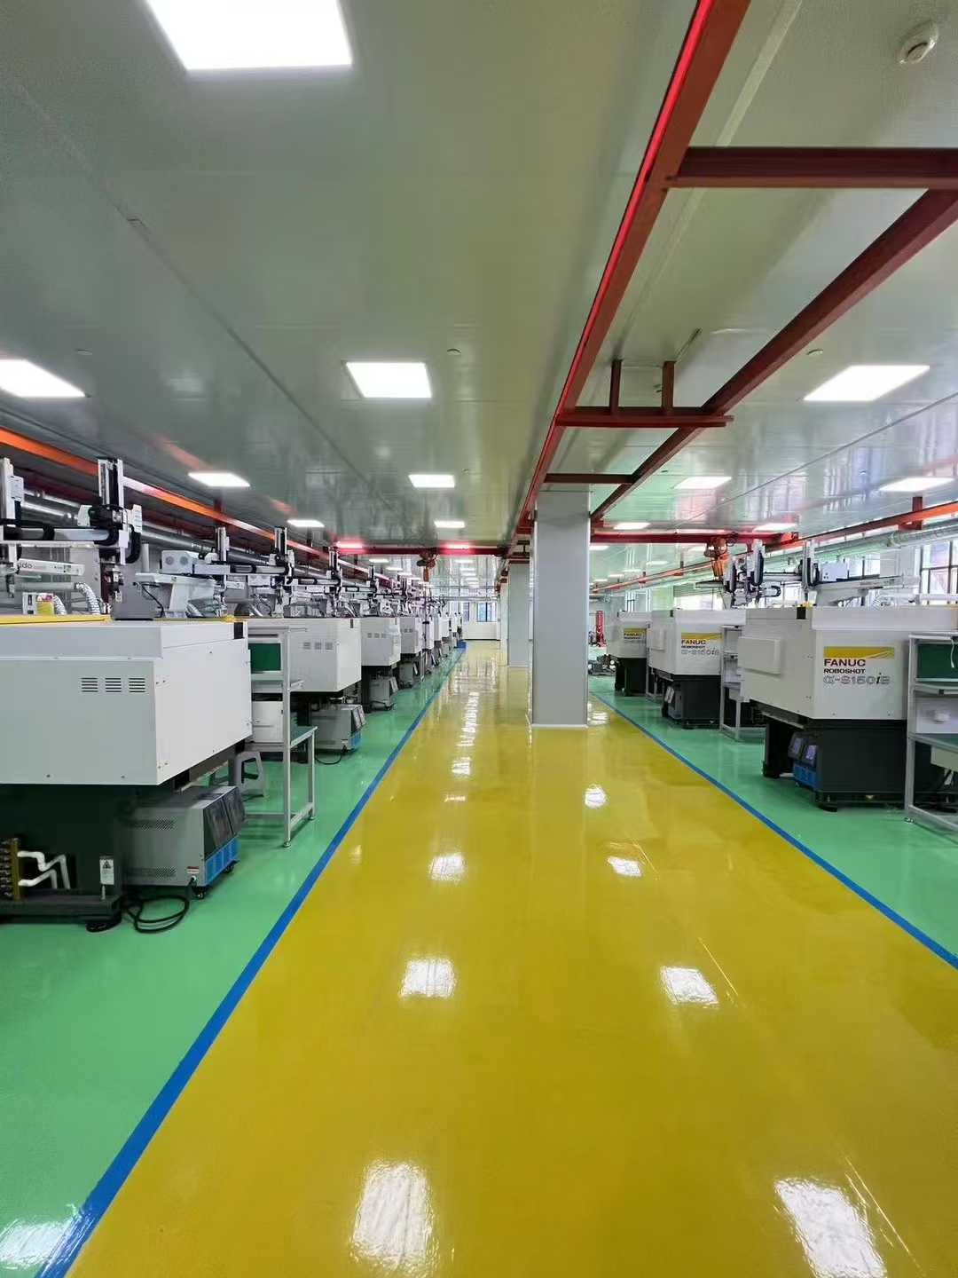
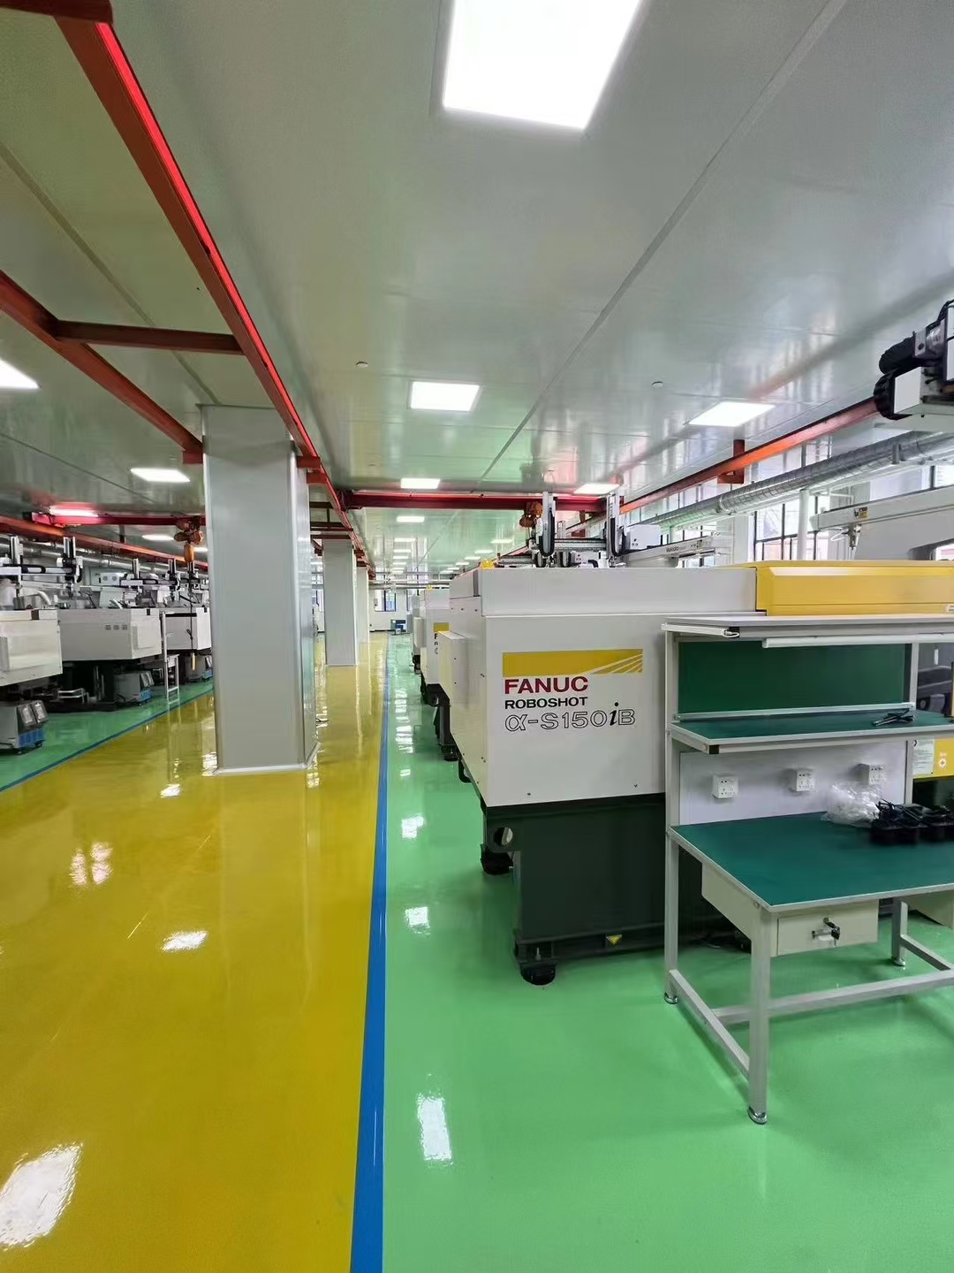
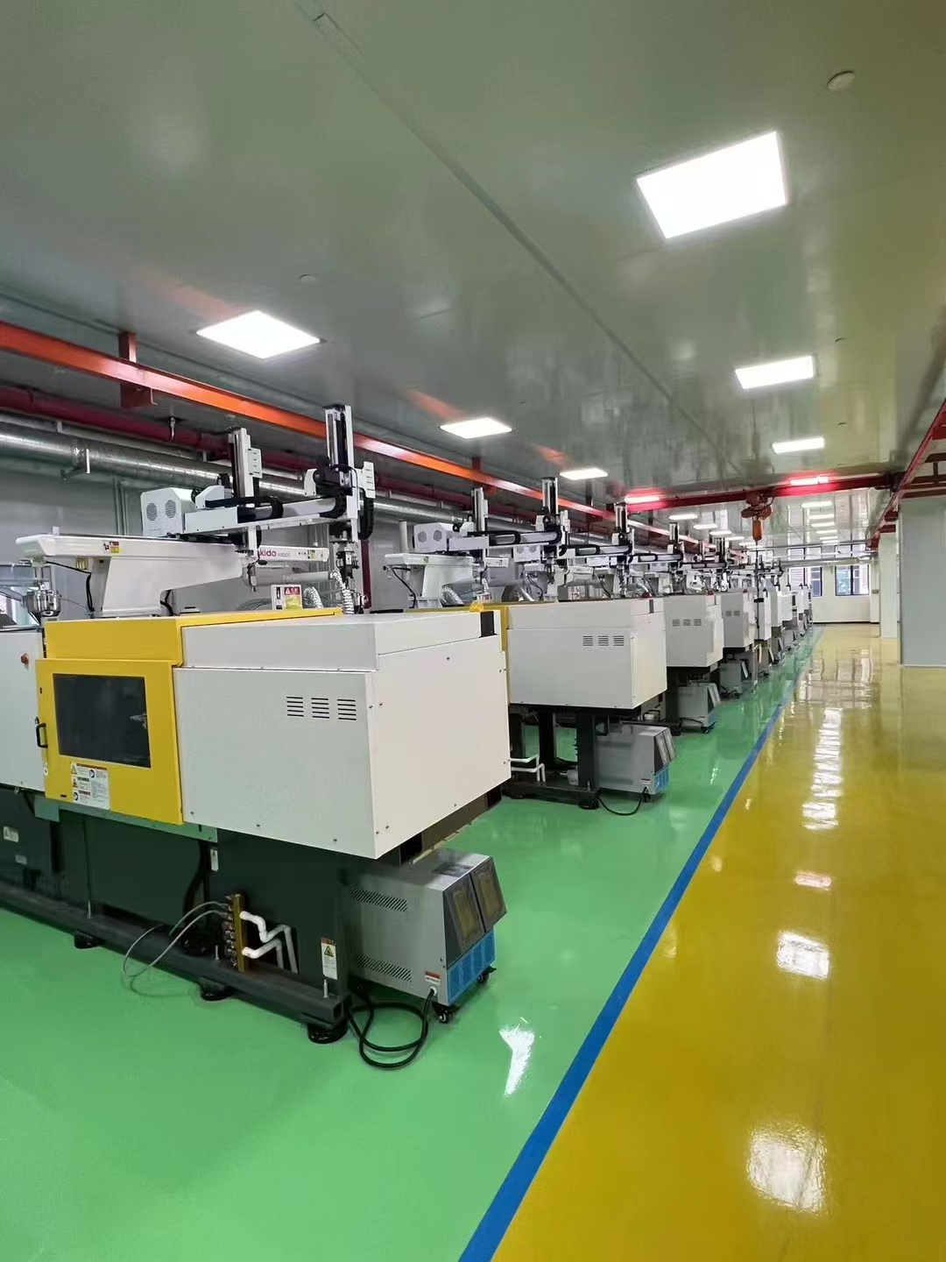
10
Injection molding
Material and process control
for repeat production.
Material confirmation, process records, first-piece approval and in-process inspection.
Notes:
中文讲解
注塑部分重点说明塑胶件如何稳定配合整个产品。原资料中的生产控制包括材料确认、参数记录、首件以及过程检查。我们还会把样品修正和最终装配要求反馈到模具与注塑控制中。这里展示注塑车间的不同现场视角。
English talk track
Injection molding supports plastic components that need to fit the complete product consistently. The production controls in our profile include material confirmation, parameter records, first-piece approval and in-process checks. Sample corrections and final-assembly requirements feed back into tooling and molding control. The photographs show the injection-molding workshop included in the supplied materials.
客户交流 / Customer discussion
塑胶件最关键的是外观、尺寸，还是与其他零件的配合？
Is the main priority appearance, dimensions or fit with other components?

Slide 11
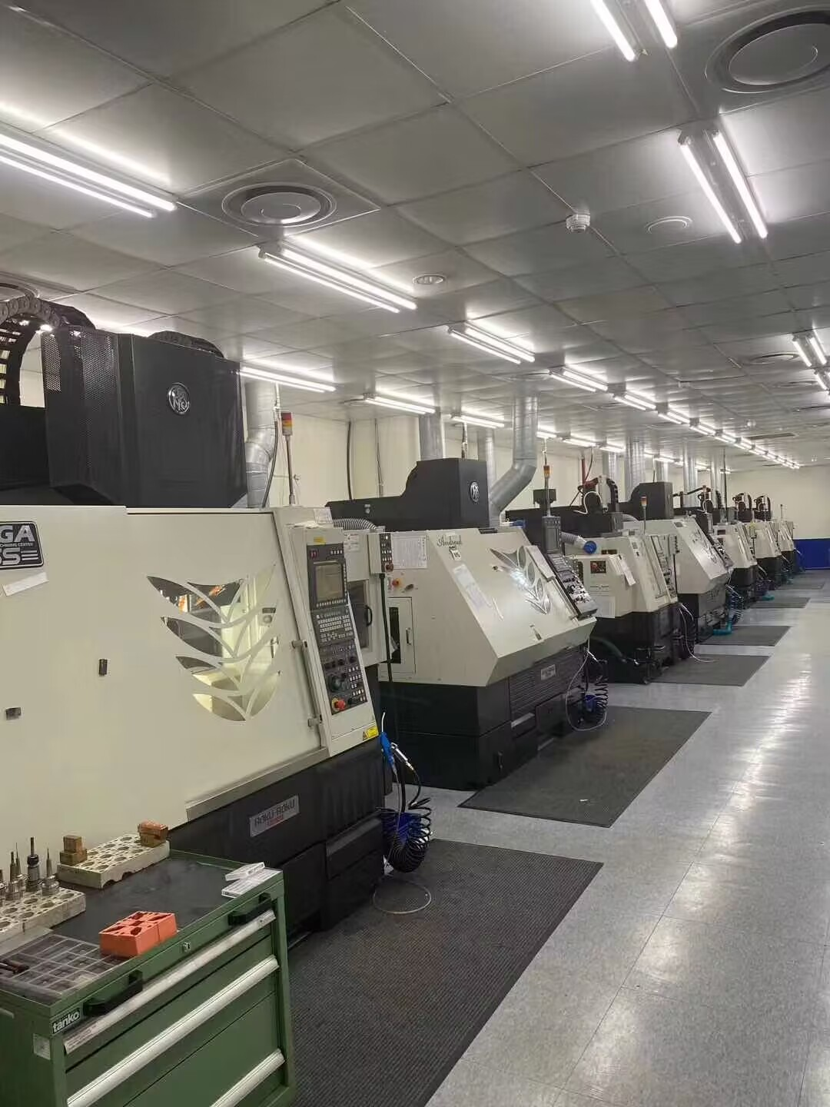
11
A coordinated
manufacturing network
A self-managed site and qualified partners,
coordinated through one customer interface.
1
5
+
Self-managed site
Qualified production
bases
Notes:
中文讲解
我们的运营模式由一个自管场地和五个合格生产基地组成。MANUVORA负责客户沟通、技术澄清、图纸和变更、质量问题、进度协调以及交付跟进。合作资源为项目提供不同的制造能力。我们把这些活动纳入统一项目管理，同时准确说明资源归属，不将合作现场全部描述为自有工厂。
English talk track
Our operating model combines one self-managed site with five qualified production bases. MANUVORA remains the customer interface for technical clarification, drawing and change control, quality communication, scheduling and delivery follow-up. Partner resources provide the process capabilities required by each project. We bring these activities into one project plan while keeping the distinction between self-managed operations and partner facilities clear.
客户交流 / Customer discussion
贵司更关注供应商的哪些责任和沟通边界？
Which supplier responsibilities and communication points are most important to your team?

Slide 12
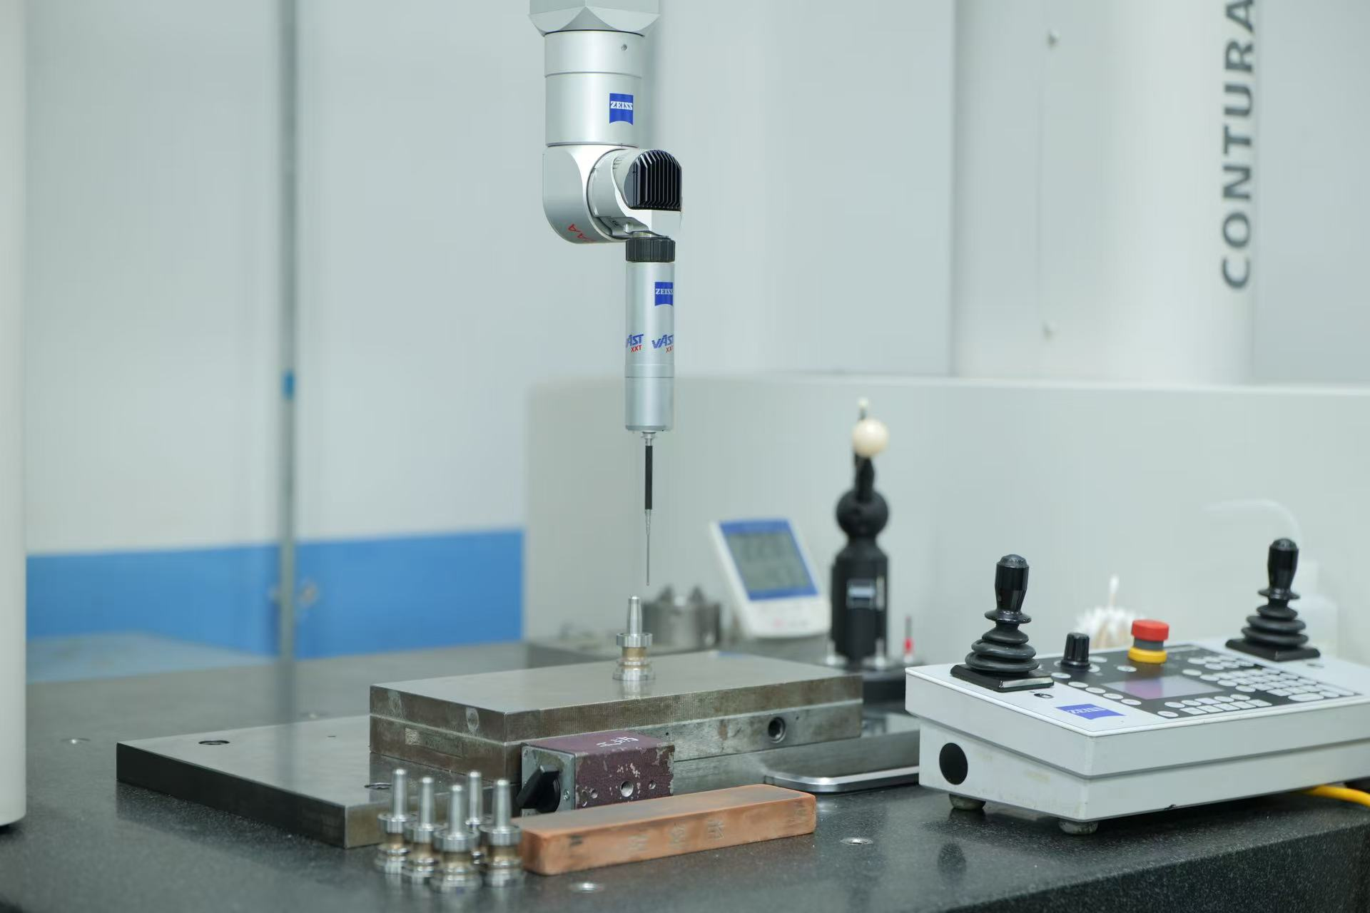
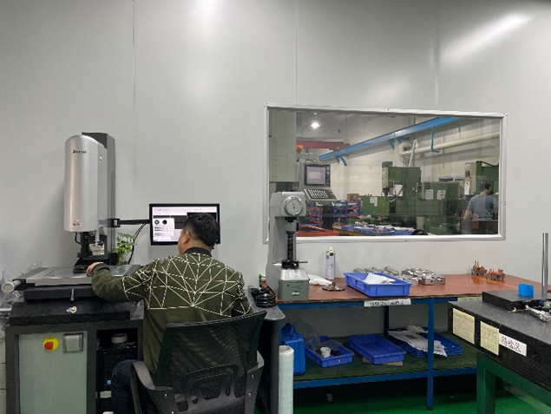
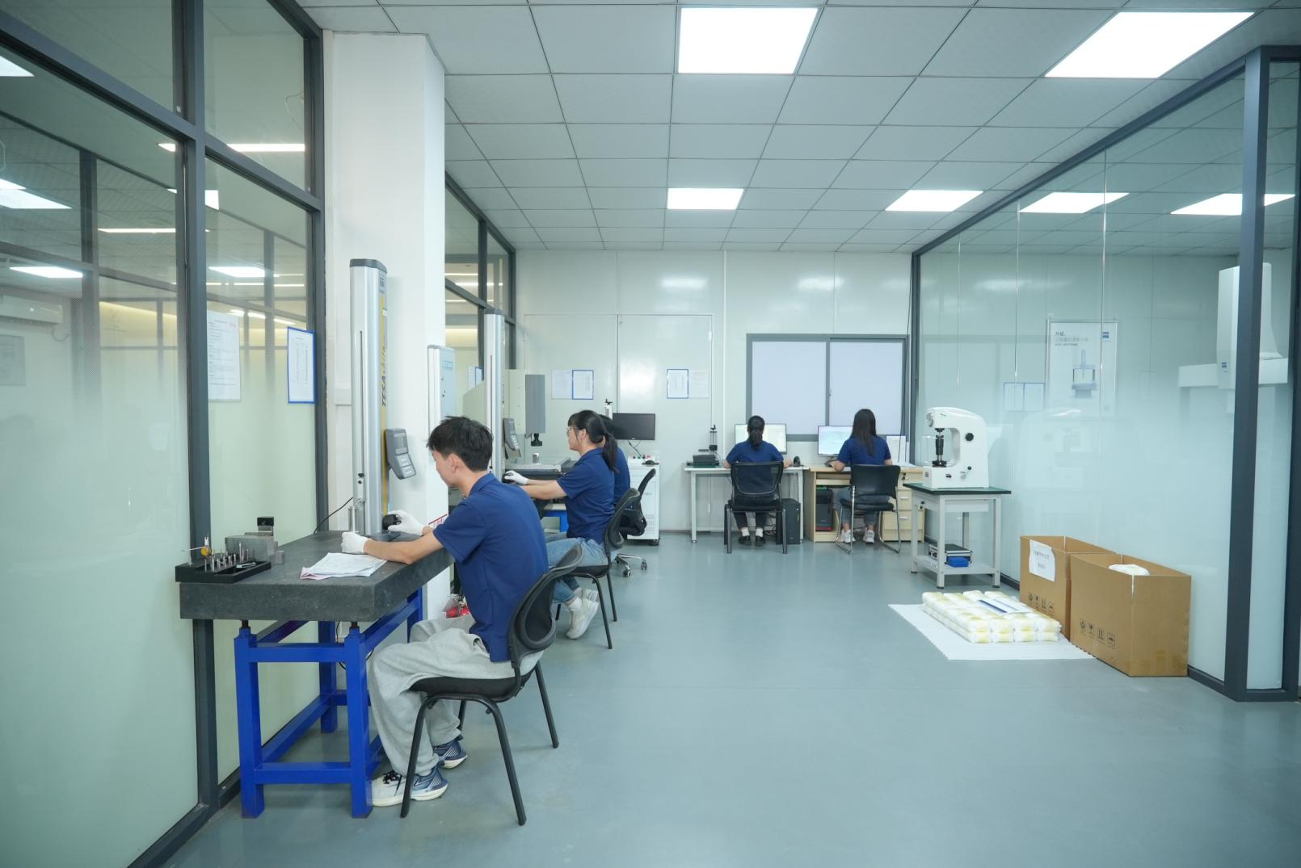
12
Dimensional
inspection
CMM and
inspection resources
Datums, critical dimensions
and approved samples
guide the inspection plan.
Inspection
resources
Methods and sampling reflect the drawing,
project risk and customer approval needs.
Notes:
中文讲解
质量控制从图纸和验收要求开始。三坐标和其他尺寸检测资源用于确认关键尺寸、基准及配合要求，并与批准样品和检验计划保持一致。照片中既有原稿中的检验现场，也有本次提供的三维检测设备。具体测量方法和抽样水平需要根据项目风险与客户的批准要求确定。
English talk track
Quality control starts with the drawing and acceptance requirements. CMM and other dimensional inspection resources support the verification of critical dimensions, datums and mating features against the inspection plan and approved samples. These photographs include inspection areas from the original profile and the supplied three-dimensional measurement equipment. The method and sampling level depend on project risk and the customer’s approval requirements.
客户交流 / Customer discussion
哪些尺寸需要全检，哪些项目需要提交首件报告？
Which dimensions require full inspection, and which items require a first-article report?

Slide 13
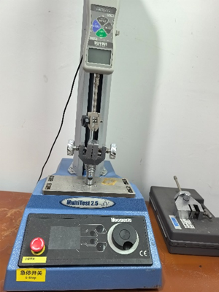
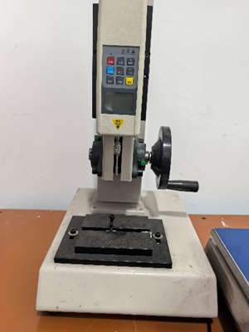
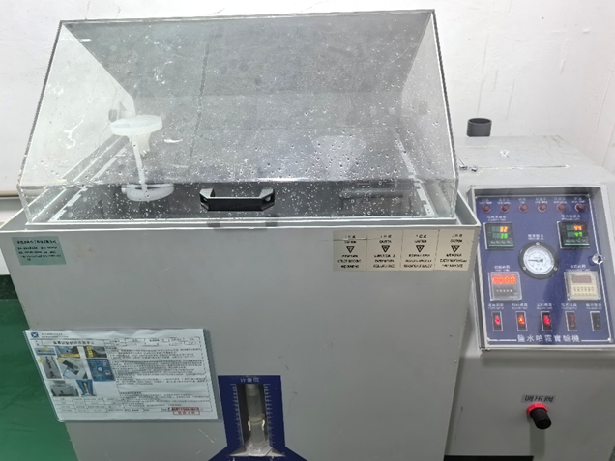
13
Testing & quality records
Project specifications define
how we test and accept parts.
Approval records
FAI and dimensional reports
PPAP when required
Material traceability
Material certificates
Inspection and lot records
Release records
Force
Hardness
Salt spray
Finish and test records
Corrective actions and sample approval
ISO 9001-certified production bases are available.
Documentation requirements are agreed for each project.
Notes:
中文讲解
除尺寸检测外，项目还可以根据要求安排力值、硬度和盐雾等测试。质量文件可以包括首件及尺寸报告、客户要求时的PPAP、材料证书、表面与测试记录、批次追溯、纠正措施和样品批准记录。原稿表述为可以提供ISO 9001认证的生产基地资源，不应将其误解为MANUVORA公司已获得所有相关行业认证。
English talk track
In addition to dimensional inspection, projects can include force, hardness and salt-spray testing when required. The agreed quality file can contain FAI and dimensional reports, PPAP when requested, material certificates, finish and test records, lot traceability, corrective actions and approved-sample records. ISO 9001-certified production bases are available within the operating model described in our company profile. The applicable records and production resource are confirmed for each project.
客户交流 / Customer discussion
请告诉我们客户批准时必须提交哪些质量文件。
Which quality documents are mandatory for your approval process?

Slide 14
14
Project execution
Clear inputs and approval
criteria at each stage.
Stage | Work scope | Release evidence
01 RFQ | NDA, drawings, volume and standards | Confirmed quotation inputs
02 REVIEW | DFM, material, process and risks | Documented assumptions and risk actions
03 DEVELOP | Prototypes, tooling, fixtures and trials | Trial results and corrections
04 APPROVE | Dimensions, finish, function and packing | Approved samples and acceptance criteria
05 PRODUCE | Incoming, in-process and final inspection | Production and inspection records
06 DELIVER | Packing, documentation and shipment | Shipment release
Notes:
中文讲解
我们用六个阶段组织项目。询价阶段明确图纸、数量、标准和时间。工程评审确定材料、工艺、公差及风险。开发阶段安排样件、模具、治具和试验修正。批准阶段确认尺寸、外观、功能和包装。生产阶段执行来料、过程和最终检验。交付阶段核对货物、记录和物流文件。每个阶段都有相应输入、输出和批准依据。
English talk track
We organize projects in six stages. RFQ confirms the drawings, volume, standards and timing. Engineering review defines the material, process, tolerances and risks. Development covers prototypes, tooling, fixtures, trials and corrections. Approval confirms dimensions, finish, function and packaging. Production includes incoming, in-process and final inspection. Delivery aligns the goods, records and shipment documents. Each stage has a defined input, output and release basis.
客户交流 / Customer discussion
您希望我们从哪一个阶段开始参与？
At which stage would you like our team to become involved?

Slide 15
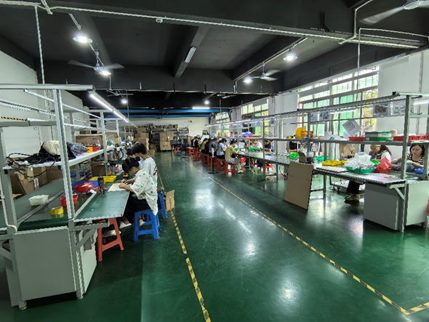
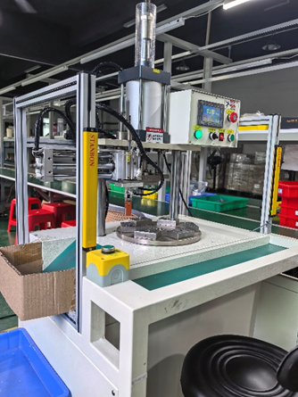
15
Assembly & functional checks
A defined assembly process
for parts that work together
Incoming checks and work instructions
Fixtures and assembly sequence
In-process and final inspection
Functional and force checks to agreed specifications
Notes:
中文讲解
多零件产品需要在加工之外规划装配。我们会检查来料、制定工位要求和装配顺序，并根据项目安排治具、过程检查以及最终检验。必要时增加功能或力值确认。原稿中的装配现场与设备照片用于展示这些活动。最终交付可以是经过检查的子组件或组装产品，并按确认的包装要求转入发货。
English talk track
Multi-part products need an assembly plan in addition to the individual manufacturing processes. We check incoming components, prepare work instructions and the assembly sequence, and arrange fixtures, in-process checks and final inspection. Functional or force checks are included when the project requires them. The original workshop and equipment photographs illustrate these activities. The agreed delivery can be an inspected subassembly or assembled product ready for packing.
客户交流 / Customer discussion
是否已有装配图、BOM和功能测试要求？
Do you already have an assembly drawing, BOM and functional-test requirements?

Slide 16
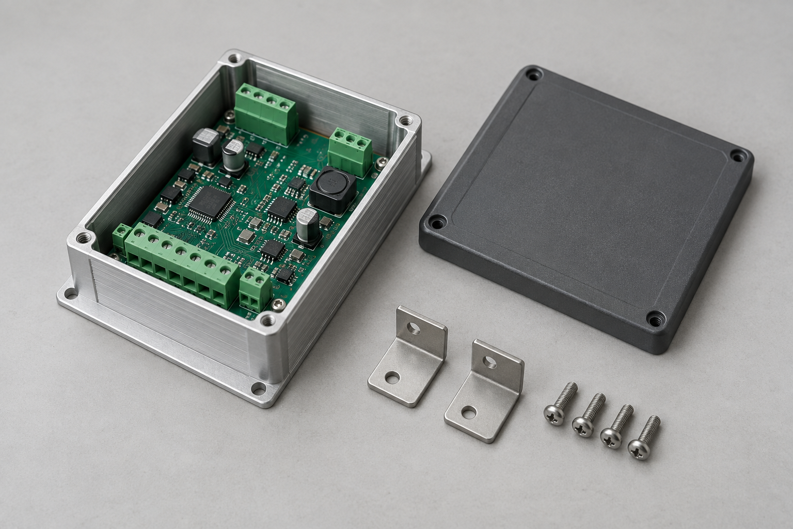
16
Electronic assembly
workflow
Plastic, metal and purchased
parts within one project scope
AI-generated illustration and fictional values. Actual project photographs and validation records to be inserted.
Example project scope
DFM and tolerance review
Tooling and component coordination
Trial assembly and functional checks
Illustrative validation
Check | Assumed target | Example result
Fit clearance | 0.20–0.40 mm | 0.28 mm
Trial assembly | 5 sample units | 5 / 5 fitted
Function | 5 sample units | 5 / 5 passed
Fit, interfaces and repeatable assembly
Notes:
中文讲解
本页为可替换的案例示例，图片由AI生成，验证表中的全部数字和通过情况均为虚构示例，不能作为已完成项目或客户测试的证明。示例产品包含金属外壳、塑胶盖板、PCB、支架和紧固件。假设项目关注配合间隙、不同零件接口以及装配一致性，可以按照DFM和公差评审、模具与零件协调、试装及功能检查的顺序组织工作。右侧表格演示如何呈现项目验证记录，例如目标间隙、试装数量和功能检查结果。实际案例应替换为真实产品、具体问题、采取的措施、实测记录和客户批准情况。
English talk track
This is a replaceable illustrative case. The image is AI-generated. Every result and pass count in the validation table is fictional and must not be presented as completed project or customer test evidence. The example combines a metal enclosure, plastic cover, PCB, brackets and fasteners. A comparable project may require control of mating clearances, component interfaces and assembly consistency. The work can be organized through DFM and tolerance review, tooling and component coordination, then trial assembly and functional checks. The table illustrates a record format for clearance, assembly quantities and function. A real case should show the actual product, specific problem, actions, measured results and customer approval.
客户交流 / Customer discussion
贵司类似产品最关心的是装配配合、功能验证，还是多种零件的供应衔接？
For a similar product, is the priority assembly fit, functional validation, or coordination of several component types?
替换清单
1. 右键主图，使用“更改图片”替换为实际案例照片。
2. 将“Example project scope”及对应工序改为真实项目工作。
3. 逐项替换验证表的检查项目、验收标准、样本量和实测结果。5件、0.28毫米、5/5均为虚构示例。
4. 补充真实客户确认或样品批准情况。
5. 只有图片与全部记录都替换为真实资料并核对后，才移除页面示例标识。
Sources and image disclosure
The original source slide 16 describes a general electronic-product program involving plastic, metal and purchased components. The detailed product shown here is an AI-generated illustrative module. All displayed validation values are fictional placeholders authorized by the user for later replacement, not factual MANUVORA project outcomes.
Image source: built-in image generation, 2026-09-09. Prompt: realistic unbranded small industrial electronics module with machined aluminum chassis, polymer cover, PCB, two brackets and four screws, on a neutral light-grey work surface. Product mockup only, no branding or test records.

Slide 17
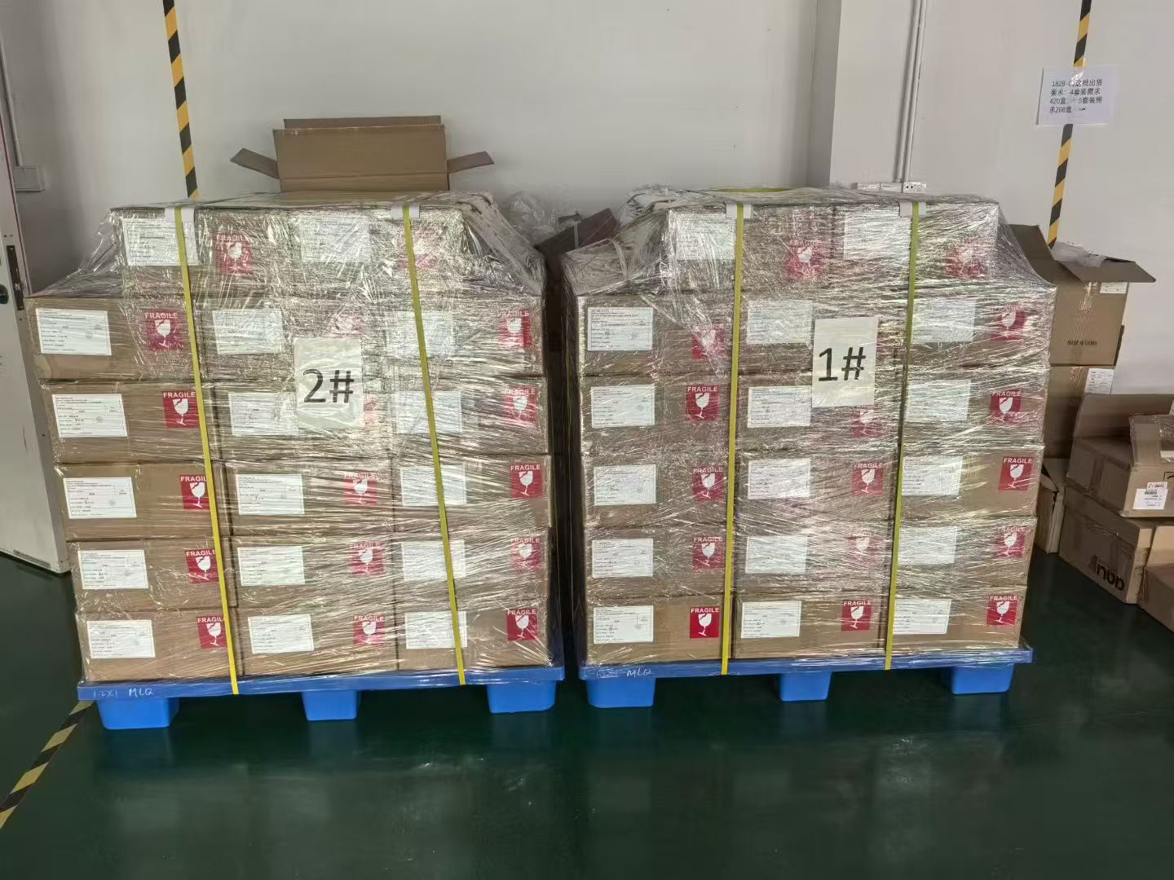
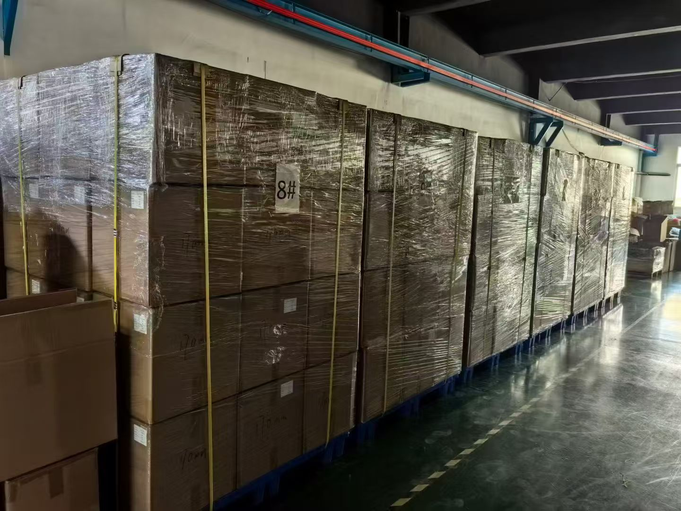
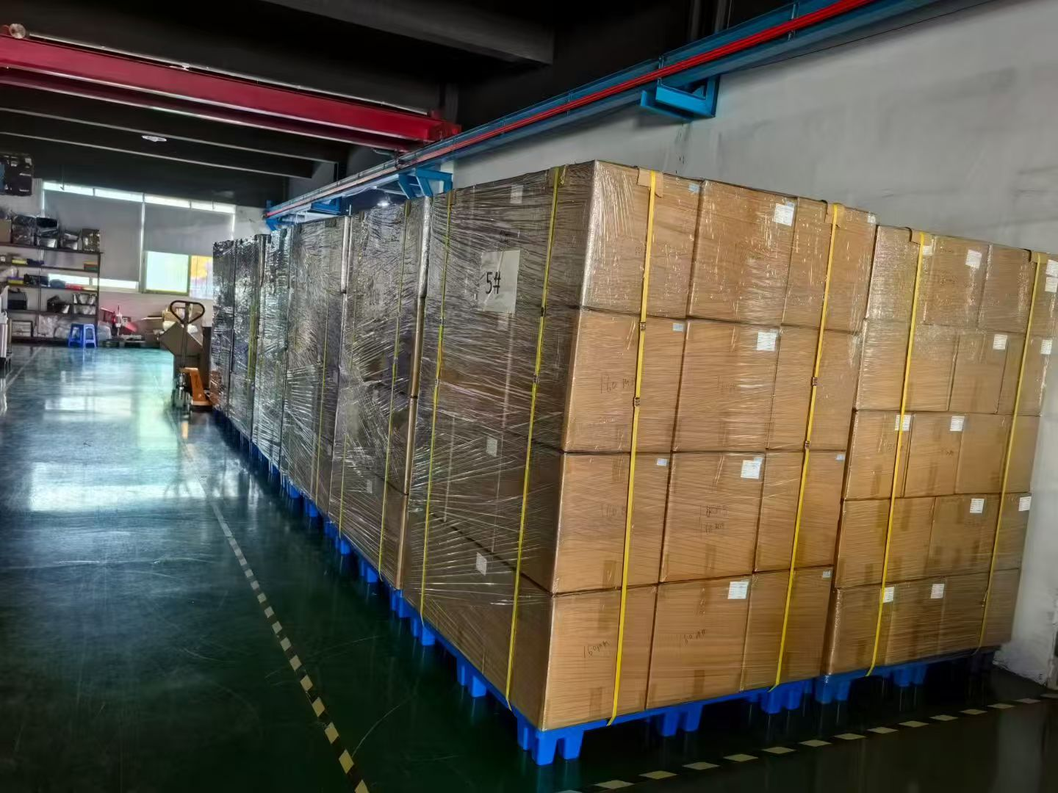
17
Packaging & shipment
Shipment release includes packed goods and complete batch records.
Labeled cartons and pallets
Batches staged for shipment
Packed goods before dispatch
Batch quantity, labeling, pallet stability and shipment documents
Notes:
中文讲解
这些是原稿中提供的实际包装和发货现场照片。发货前核对批次、数量、箱标、易碎标识、包装状态和托盘稳定性，并确认装箱清单与客户要求的物流文件。对于整合交付项目，制造、装配和包装的信息需要一致，才能按批次完成放行。客户的特殊标签、包装或运输要求应在项目阶段提前确认。
English talk track
These photographs show actual packed goods staged for shipment. Before release, the checks cover batch and quantity, carton labels, fragile markings, packing condition and pallet stability, together with the packing list and required logistics documents. For an integrated project, manufacturing, assembly and packing records need to align before batch release. Special labeling, packaging and transport requirements should be confirmed during project planning.
客户交流 / Customer discussion
是否有指定包装、箱标、托盘或出货文件格式？
Do you have specified packaging, labeling, pallet or shipment-document formats?

Slide 18
18
Industries &
project fit
Industry | Typical project needs
Industrial automation | Machined parts, fixtures, brackets and assemblies
Smart hardware | Product iteration, mixed processes and assembly
Robotics | Lightweight structures and custom mechanisms
Electronics | Housings, contacts, thermal parts and subassemblies
Medical devices | Documentation, traceability and change control
Automotive support | Precision parts and structured quality evidence
Prototype validation, production
to drawing and supply-chain
transfers.
Support for components
and assembly programs.
Notes:
中文讲解
我们的运营模式适合工业自动化、智能硬件、机器人、电子、医疗器械配套和汽车相关零件项目。这里说明的是匹配的产品与项目需求，具体资质、规范和质量文件仍需随项目确认。合作可以从样件和工程验证开始，也可以是按图生产、供应链转移、降本或多零件装配。通常可以先选择一个有代表性的零件或组件，让双方确认工程、质量和交付的协作方式。
English talk track
Our operating model can fit industrial automation, smart hardware, robotics, electronics, medical-device support and automotive-support projects. This page describes the relevant project needs. Any specific qualifications, standards and quality-document requirements are confirmed for the individual program. Cooperation can begin with prototypes and engineering validation, drawing-based production, supply-chain transfer, cost or process improvement, or multi-part assembly. A representative part or assembly provides a useful starting point for agreeing the working process.
客户交流 / Customer discussion
贵司现在处于开发验证、量产，还是供应商转移阶段？
Is your current program in development, repeat production or supplier transfer?

Slide 19
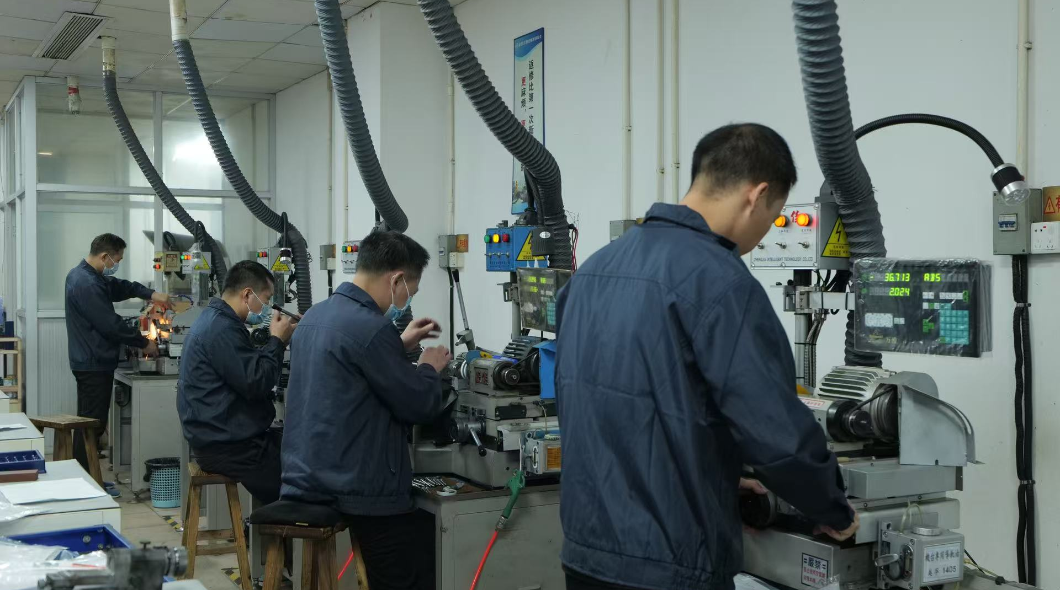
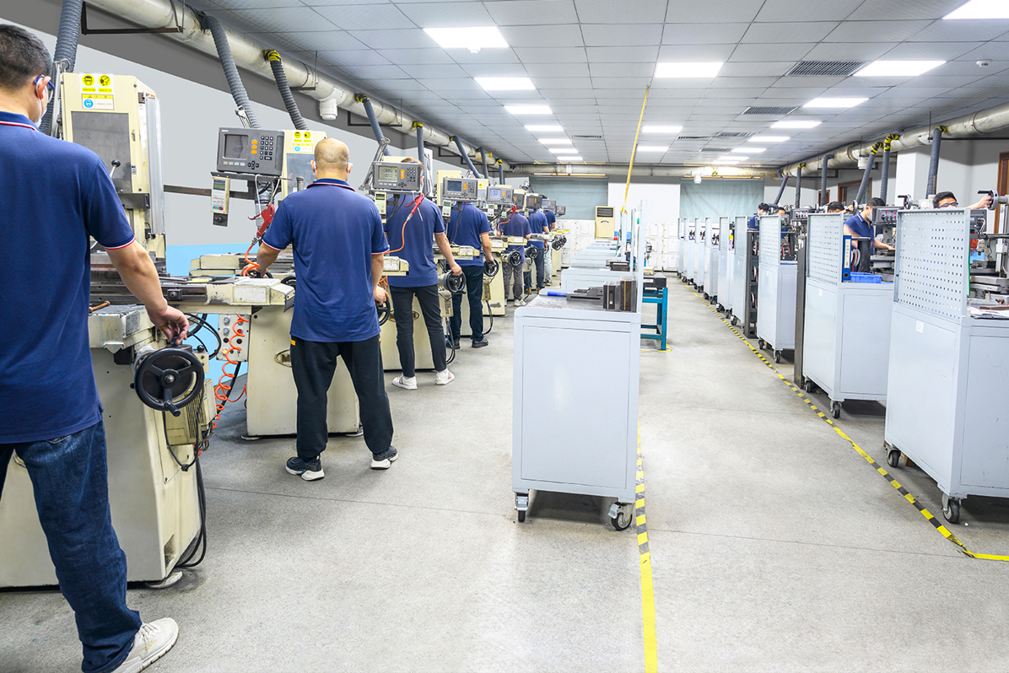
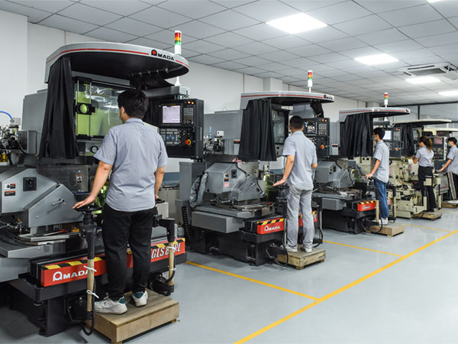
20
Production resources
Machining and grinding across the manufacturing network.
Punch-tool machining
Grinding
workshop
Optical grinding
Resource allocation follows the confirmed process route and project requirements.
Notes:
中文讲解
这一页供客户深入了解生产资源时补充使用。照片分别来自本次压缩包中的冲子机车间、磨床车间和光学研磨资料。它们展示可供项目匹配的工艺资源，具体使用的场地、设备和验收能力应随实际零件确认。您可以根据客户对治具、模具零件或精密加工的兴趣，选择展开这一页。
English talk track
This supplementary page provides additional manufacturing-resource photographs. The images come from the supplied punch-tool machining, grinding-workshop and optical-grinding materials. They illustrate process resources that can be matched to a project. The actual site, equipment and acceptance capability are confirmed for the specific part. This page supports a more detailed discussion of tooling components, fixtures or precision work.
客户交流 / Customer discussion
贵司对研磨、治具或模具零件有哪些具体要求？
What requirements do you have for grinding, fixtures or tooling components?

Slide 20
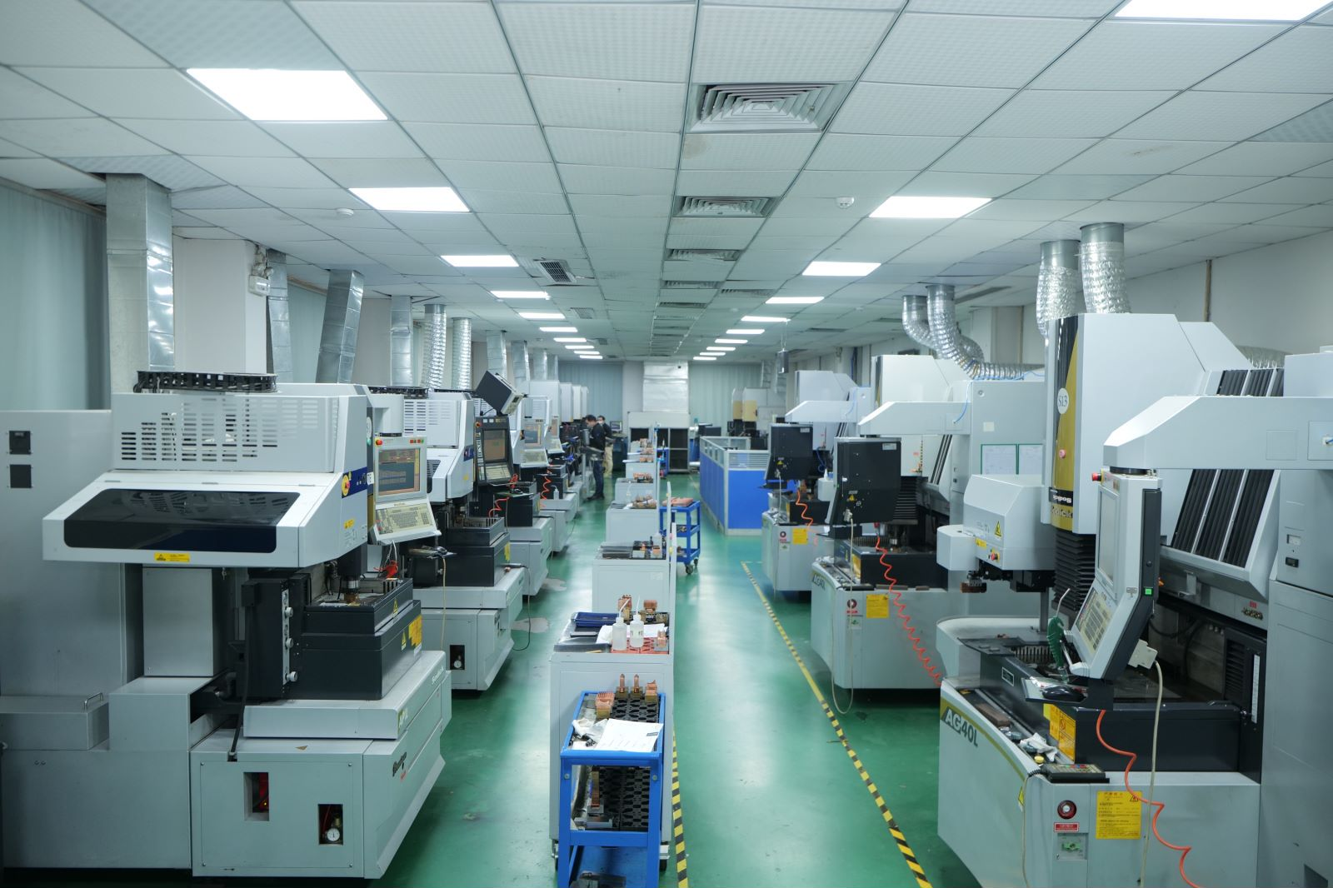
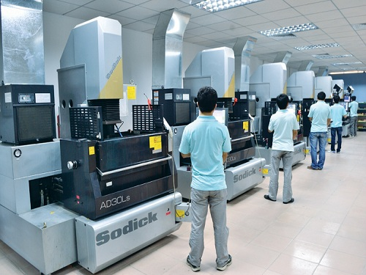
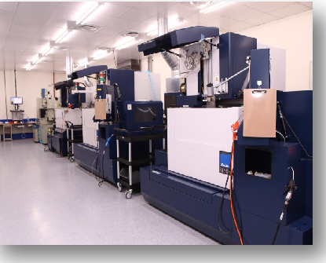
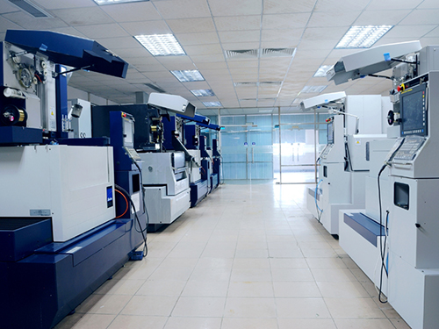
21
EDM &
wire cutting
Equipment references across
the manufacturing network.
EDM sinking
Wire EDM
Wire cutting
Notes:
中文讲解
这组照片补充展示电火花及线切割资源，包括电火花车间、成形电火花设备和线切割设备。此处只根据所提供的照片和文件名称标识工艺，不额外承诺未经资料支持的设备数量、加工精度或产能。若客户有相关需求，可以继续结合图纸确认结构和加工方案。
English talk track
These photographs add detail on EDM and wire-cutting resources, including the supplied EDM workshop, sinking EDM equipment and wire-cutting equipment. The captions identify the processes shown in the provided materials. Equipment quantities, machining tolerances and capacity are established through the actual project review. For relevant inquiries, the next step is to assess the drawing and confirm the proposed manufacturing route.
客户交流 / Customer discussion
是否有细槽、型腔或特殊轮廓需要进一步评审？
Are there slots, cavities or special profiles that need a closer engineering review?

Slide 21
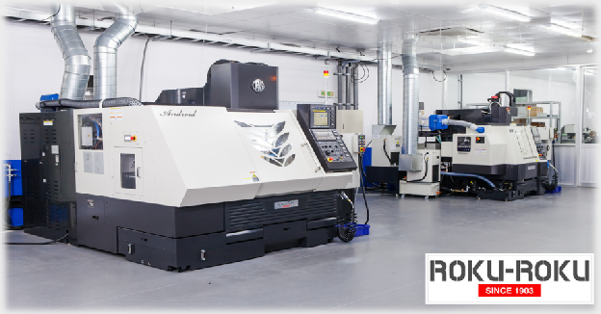
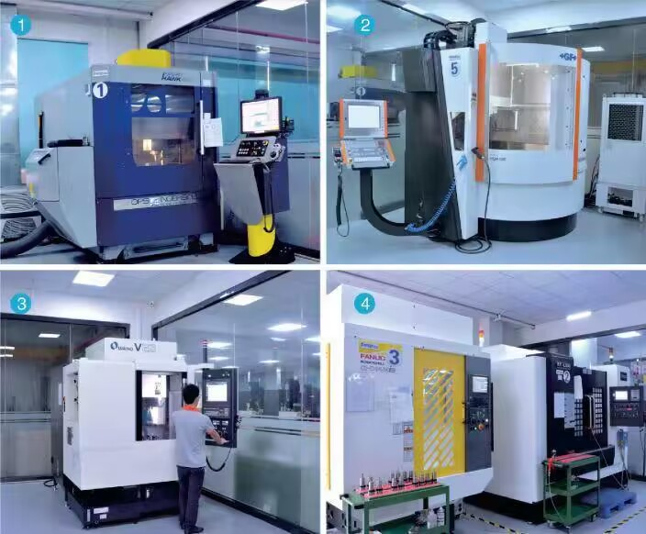
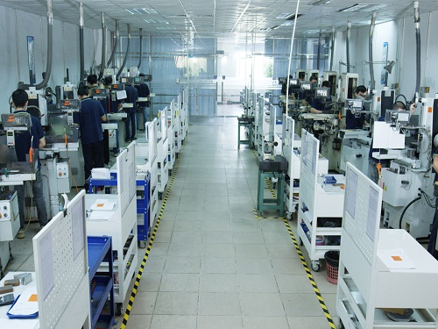
22
Additional production
resources
CNC and grinding
equipment across
the network.
CNC equipment
Precision CNC resources
Surface grinding
Production-network references. Final equipment selection follows the project requirements.
Notes:
中文讲解
最后一页保留本次资料中的其他CNC及平面磨削设备照片。这些资源可以根据具体零件的工艺要求进行匹配。对于客户的具体图纸，仍需确认相应工艺、设备匹配和检验方案后再进行承诺。结束讨论时，可以回到项目需求和下一步工程输入。
English talk track
This final supplementary page retains additional CNC and surface-grinding equipment photographs from the supplied materials. For a customer drawing, the team still needs to confirm the process route, equipment fit and inspection plan before making a project commitment. The discussion can then return to the customer’s requirements and the engineering inputs needed for the next step.
客户交流 / Customer discussion
接下来是否可以确认图纸版本、材料、数量和验收要求？
Can we next confirm the drawing revision, material, quantity and acceptance requirements?
Sources
User-provided MANUVORA_Company_Profile_2026_Bilingual_Talk_Track_Editable(1).pptx, slides 4, 5, 6.
Photographs supplied in the PPTX and 新建文件夹.zip:
Z04: CNC.png
Z08: Precision CNC.jpg
Z11: surface grinding machines (Mitsui).jpg

Slide 22
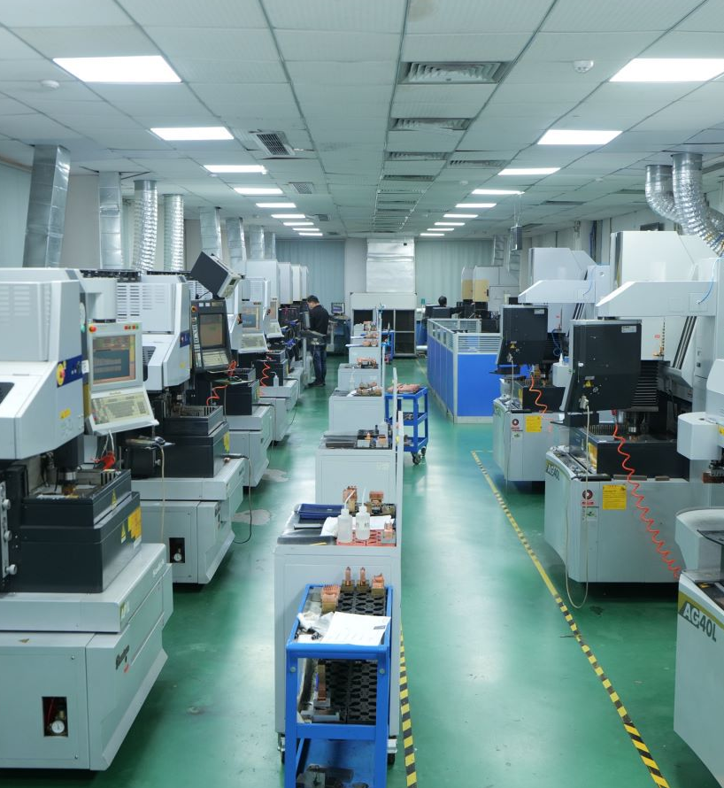
PROJECT ENQUIRIES
Your next
manufacturing project
Send 2D/3D drawings or a sample,
with the target quantity and key requirements.
Shirley
Business Development
Mobile / WhatsApp: +86 177 7738 1727
Notes:
中文讲解
如果您有新开发或准备转移的项目，可以先发来2D或3D图纸、样品、目标数量和关键要求。我们会评审可制造性、主要风险、工艺方案、质量文件和交付路径，再推进报价或样品。前期沟通由Shirley协调，联系方式为+86 177 7738 1727。后面的补充页展示更多设备和车间资源，可以根据客户关注的工艺继续展开。
English talk track
If you have a new development or a program you are considering transferring, please share the 2D or 3D drawings, a sample, target volume and key requirements. We will review manufacturability, the main risks, process options, quality records and the delivery path before moving to quotation or samples. Shirley coordinates the initial discussion and can be reached at +86 177 7738 1727. The following supplementary pages provide further workshop and equipment photographs for a more detailed process discussion.
客户交流 / Customer discussion
会后是否方便提供一个代表性零件或组件供我们评估？
Could you share one representative part or assembly for our review after the meeting?

